Slide 1
SIMON’S ALGORITHM
Steven Willis
NYC Quantum Computing
2018

Slide 2
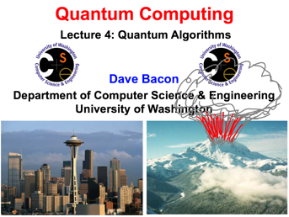
SIMON’S ALGORITHM

Slide 3
The talk
The Problem of Find a Period within data
Complexity
The Math
Single step through the algorithm (qdb)

Slide 4
Finding the period

Slide 5
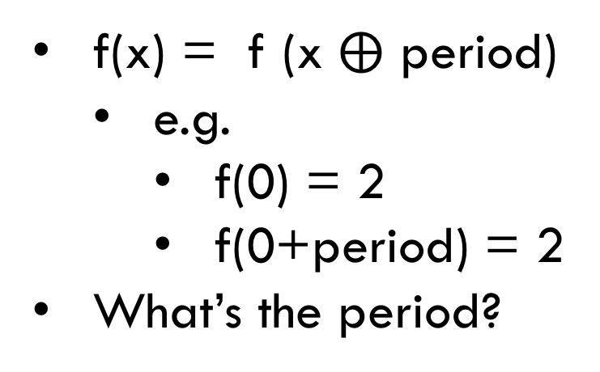

A particular type of period – XOR $⨁$
Index | 0 | 1 | 2 | 3 | 4 | 5 | 6 | 7
 | 2 | 5 | 5 | 2 | 6 | 1 | 1 | 6
Binary | 010 | 101 | 101 | 010 | 110 | 001 | 001 | 110
f(x) = f (x $⨁$ period)
e.g.
f(0) = 2
f(0+period) = 2
What’s the period?

Slide 6
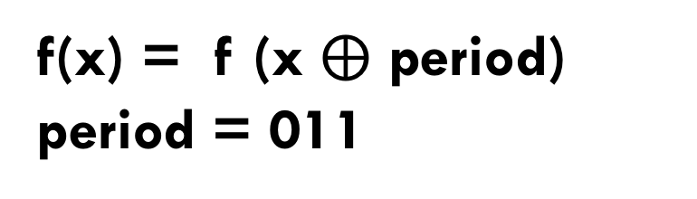
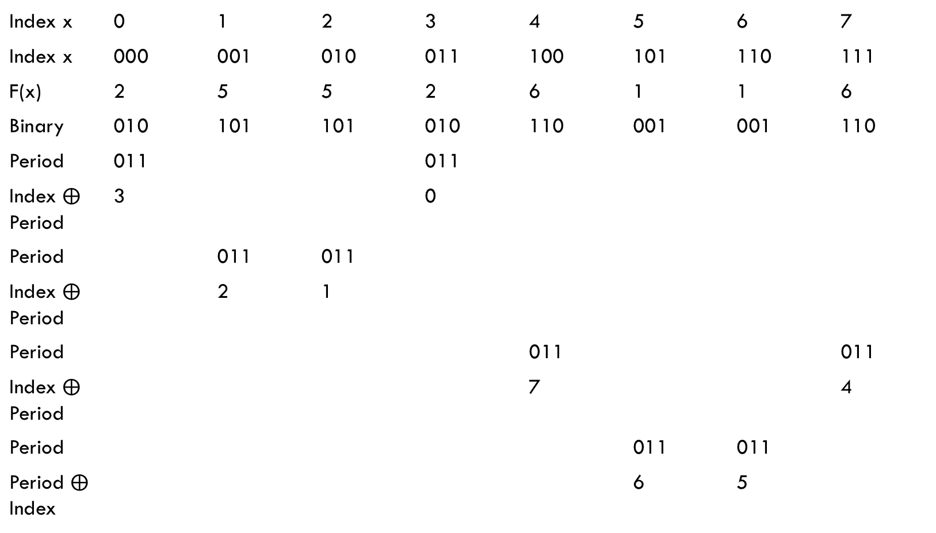
Finding the period (XOR)
Index x | 0 | 1 | 2 | 3 | 4 | 5 | 6 | 7
Index x | 000 | 001 | 010 | 011 | 100 | 101 | 110 | 111
F(x) | 2 | 5 | 5 | 2 | 6 | 1 | 1 | 6
Binary | 010 | 101 | 101 | 010 | 110 | 001 | 001 | 110
Period | 011 |  |  | 011
Index $⨁$ Period | 3 |  |  | 0
Period |  | 011 | 011
Index $⨁$ Period |  | 2 | 1
Period |  |  |  |  | 011 |  |  | 011
Index $⨁$ Period |  |  |  |  | 7 |  |  | 4
Period |  |  |  |  |  | 011 | 011
Period $⨁$ Index |  |  |  |  |  | 6 | 5
f(x) = f (x $⨁$ period)
period = 011

Slide 7
SIMON – The problem
for (x = 0 to N - 1) { for (y = x to N - 1) { if (x != y) { for (s = 0 to N – 1) { if (f(x) == f(y) && (y == x XOR s) { Print(“found it!”, s);}
}
}
} }
} Found it! 011
x | F(x)
000 | 010
001 | 101
010 | 101
011 | 010
100 | 110
101 | 001
110 | 001
111 | 110

Slide 8
SIMon’s Algorithm
A contrived algorithm to show quantum supremacy
Classic is O(2 ^{n-1}), Quantum is O(poly n)
Exploits the Hadamard Transform and quantum interference
Simon observed : the Quantum Discrete Fourier Transform is similar to the Hadamard
Uses “quantum sampling” to generate a potential solution
Accumulate and classically solve a set of linear equations
Has a probabilistic result
Is the inspiration for Shor’s algorithm (Abelian Hidden Subgroup Problem)

Slide 9
Big O Charts via Eric Rowell

Slide 10
SIMON An ARTIFICIAL EXAMPLE of Quantum speedup
f : {0,1}^{n} -> {0,1)^{m}
E.g. reverse bit order, compute squares, find a pattern
Two promises about the function (but not the exact values)
1:1
There’s two values of f(x) and f(x’) such that x and x’ differ by XOR’ing a secret value s
What’s s?

Slide 11
It’s all about complexity reduction
The classical version has a 2~^{n} use of memory and time (e.g. running through the table twice)
The quantum version doesn’t. It uses superposition and quantum fourier transforms to reduce the complexity to relating to n
It’s a probabilistic answer with a probabilistic polynomial number of steps

Slide 12
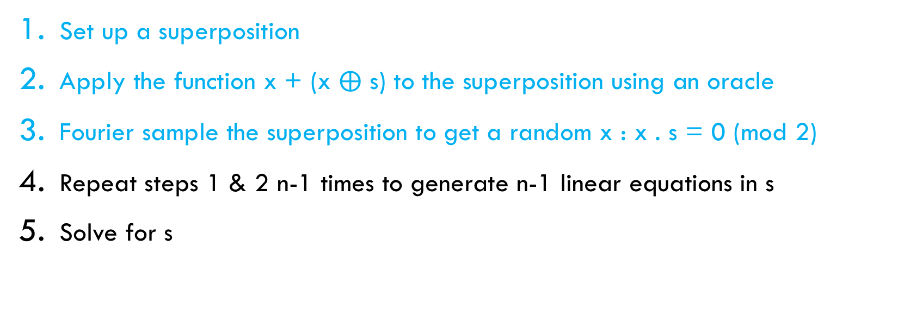
The recipe
Set up a superposition
Apply the function x + (x $⨁$ s) to the superposition using an oracle
Fourier sample the superposition to get a random x : x . s = 0 (mod 2)
Repeat steps 1 & 2 n-1 times to generate n-1 linear equations in s
Solve for s

Slide 13
Overall execution
Quantum processing for Simon’s
Classic Processing of linear equations
Run 1
s₁x₁ + s₂x₂ + s₃x₃ = 0 mod 2
Run 2
s₁x₁ + s₂x₂ + s₃x₃ = 0 mod 2
Run 3
s₁x₁ + s₂x₂ + s₃x₃ = 0 mod 2

Slide 14
Programmer’s point-of-view
Lets “single step” through 5 quantum “instructions”
A simple search algorithm
Using a single input table
A single output
Quantum Reality
Can’t really look at intermediate values (there’s no single step)
Quantum “Instructions” are really unitary matrix transformations
Measurement has side effects
(Certain sequence of instructions - entanglement - have strange side effects)

Slide 15
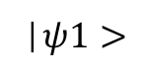
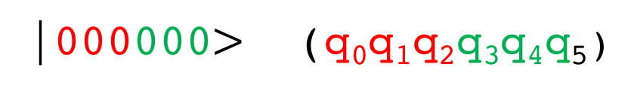
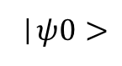
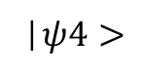
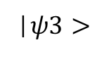
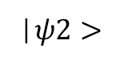
0
1
2
3
4
5
q₀
H
|0>
|0>
H
H
M
6
q₁
q₂
|0>
F(x)
q₃
|0>
M
q₄
|0>
q₅
|0>
|$ψ0>$
|$ψ1>$
|$ψ2>$
|$ψ3>$
|$ψ4>$
|000000$>$ (q₀q₁q₂q₃q₄q₅)

Slide 17
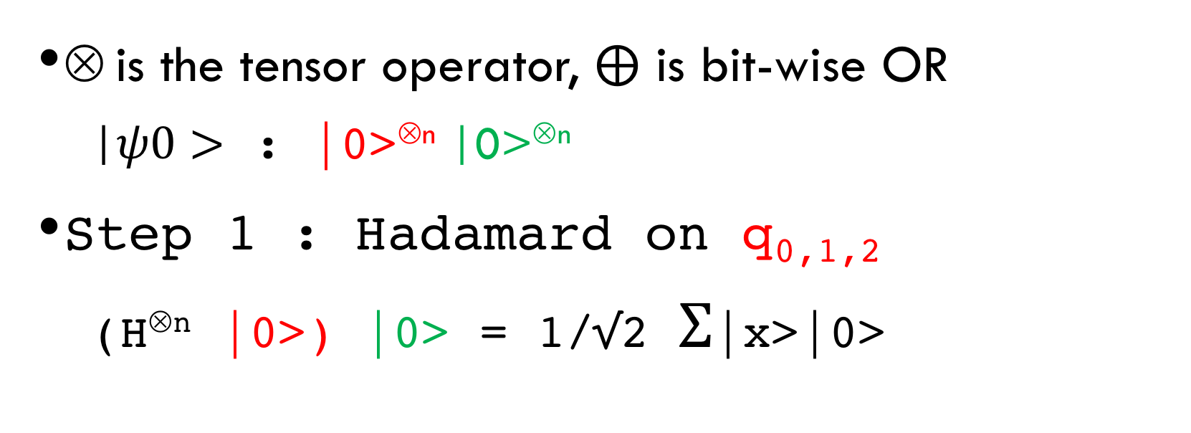
THeory
x | F(x)
000 | 010
001 | 101
010 | 101
011 | 010
100 | 110
101 | 001
110 | 001
111 | 110
⊗ is the tensor operator, $⨁$ is bit-wise OR
|$ψ0>$ : |0>^{⊗n} |0>^{⊗n}
Step 1 : Hadamard on q_{0,1,2}
(H^{⊗n} |0>) |0> = 1/√2 Σ|x>|0>

Slide 18
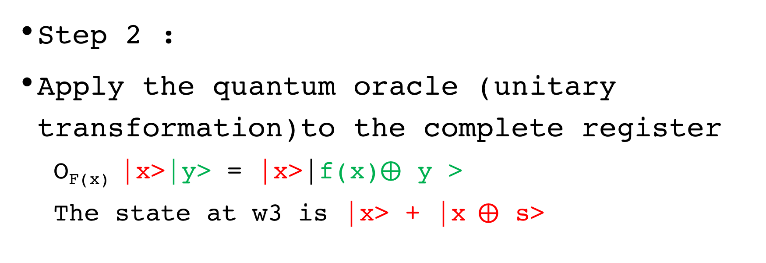
THeory
x | F(x)
000 | 010
001 | 101
010 | 101
011 | 010
100 | 110
101 | 001
110 | 001
111 | 110
Step 2 :
Apply the quantum oracle (unitary transformation)to the complete register
O_{F(x)} |x>|y> = |x>|f(x)$⨁$ y >
The state at w3 is |x> + |x$⨁$ s>

Slide 19
The Oracle (STEP 2)
x | F(x)
000 | 010
001 | 101
010 | 101
011 | 010
100 | 110
101 | 001
110 | 001
111 | 110

Slide 20
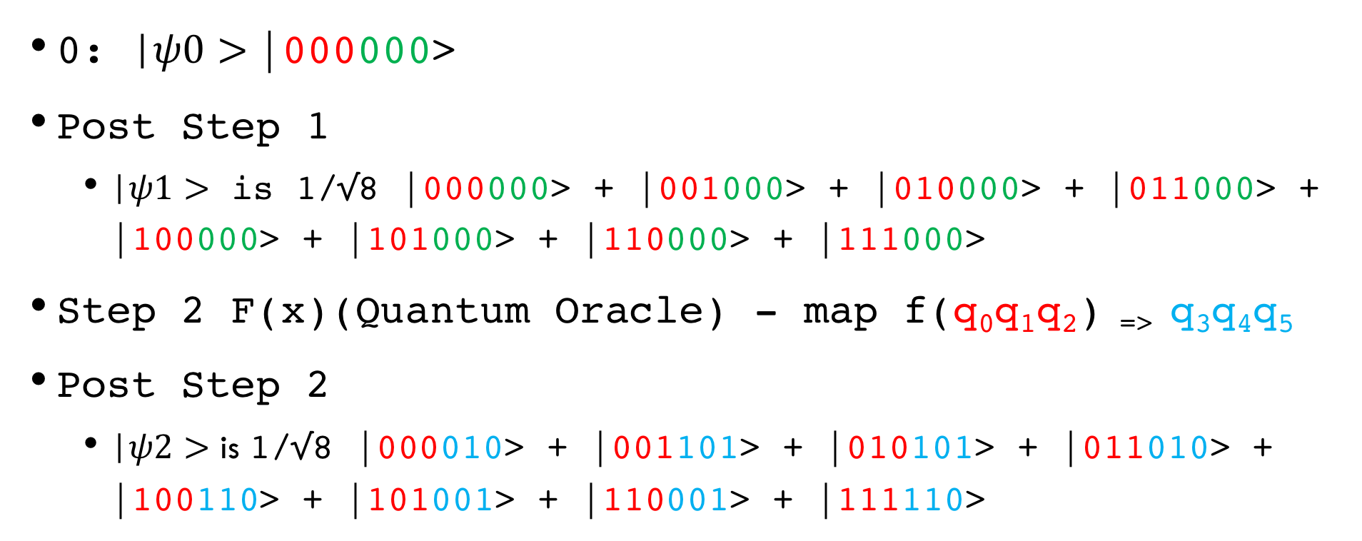
RUNNING Example (1)
x | F(x)
000 | 010
001 | 101
010 | 101
011 | 010
100 | 110
101 | 001
110 | 001
111 | 110
0: |$ψ0>$|000000>
Post Step 1
|$ψ1>$ is 1/√8 |000000> + |001000> + |010000> + |011000> + |100000> + |101000> + |110000> + |111000>
Step 2 F(x)(Quantum Oracle) - map f(q₀q₁q₂) _{=>} q₃q₄q₅
Post Step 2
|$ψ2>$ is 1/√8 |000010> + |001101> + |010101> + |011010> + |100110> + |101001> + |110001> + |111110>

Slide 21
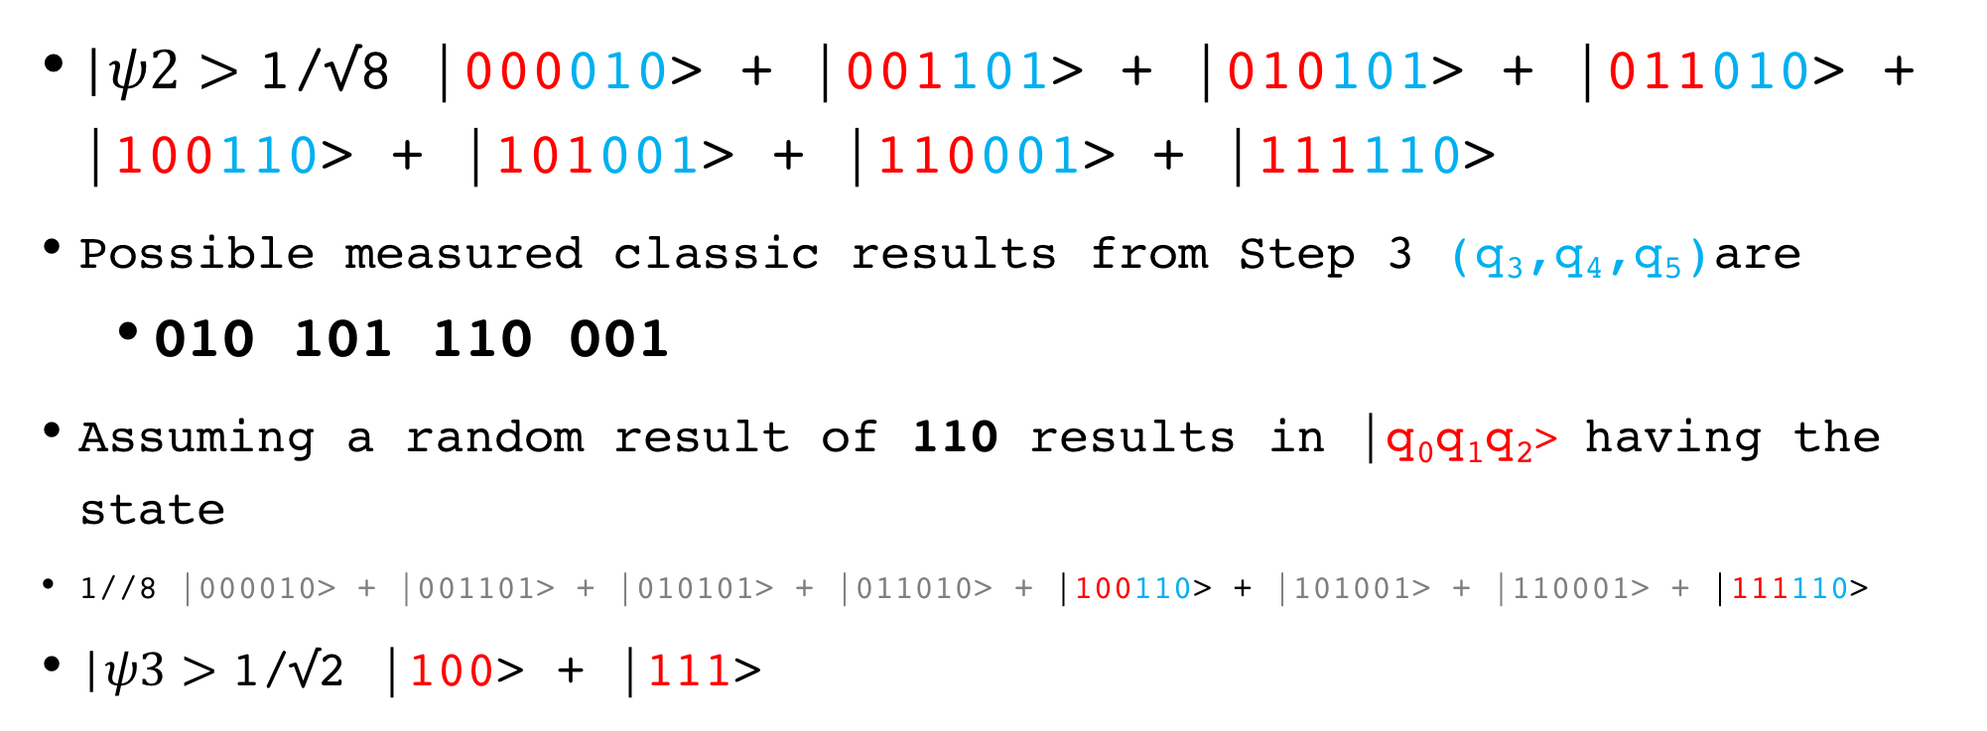
RUNNING Example (2)
x | F(x)
000 | 010
001 | 101
010 | 101
011 | 010
100 | 110
101 | 001
110 | 001
111 | 110
|$ψ2>$ 1/√8 |000010> + |001101> + |010101> + |011010> + |100110> + |101001> + |110001> + |111110>
Possible measured classic results from Step 3 (q₃,q₄,q₅)are
010 101 110 001
Assuming a random result of 110 results in |q₀q₁q₂> having the state
1//8 |000010> + |001101> + |010101> + |011010> + |100110> + |101001> + |110001> + |111110>
|$ψ3>$ 1/√2 |100> + |111>

Slide 22
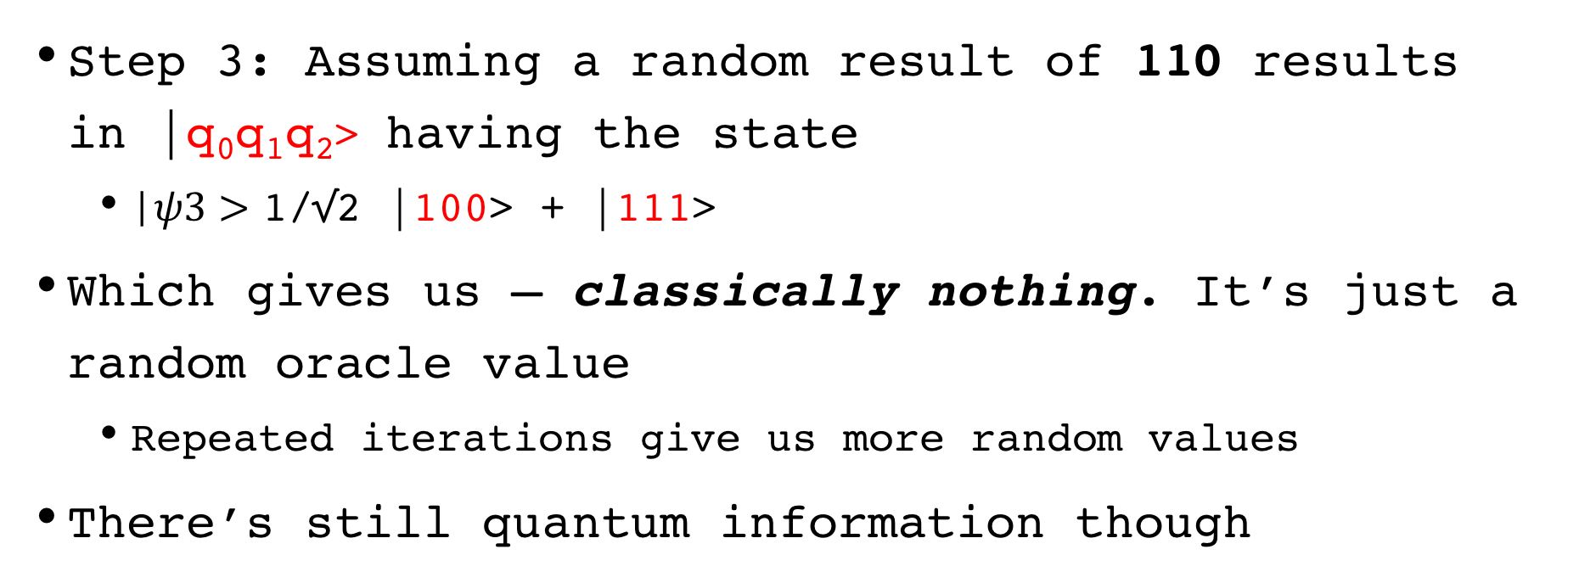
RUNNING Example (3)
x | F(x)
000 | 010
001 | 101
010 | 101
011 | 010
100 | 110
101 | 001
110 | 001
111 | 110
Step 3: Assuming a random result of 110 results in |q₀q₁q₂> having the state
|$ψ3>$ 1/√2 |100> + |111>
Which gives us – classically nothing. It’s just a random oracle value
Repeated iterations give us more random values
There’s still quantum information though

Slide 23
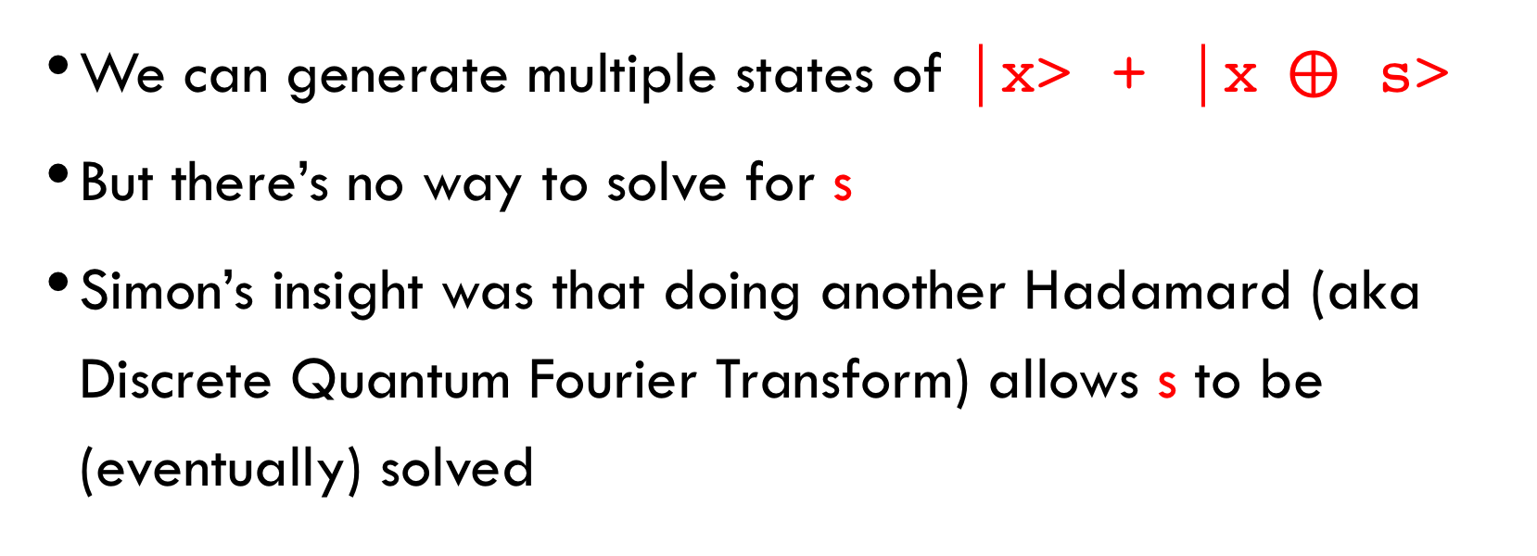
Where are we?
We can generate multiple states of |x> + |x$⨁$ s>
But there’s no way to solve for s
Simon’s insight was that doing another Hadamard (aka Discrete Quantum Fourier Transform) allows s to be (eventually) solved

Slide 24
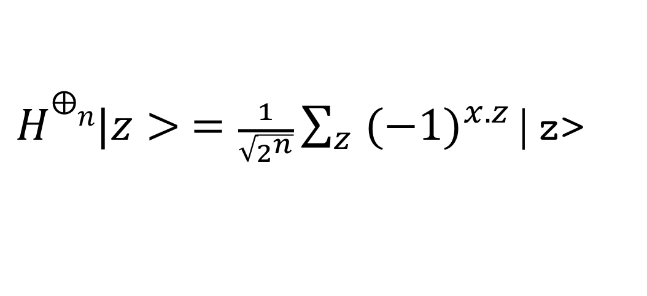
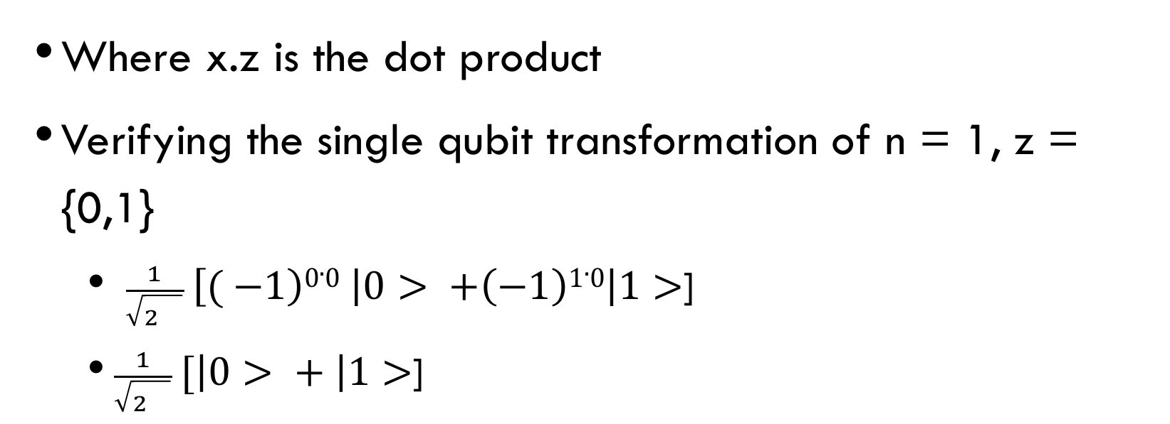
Serious definition of Hadamard
$H⨁n|z> =\frac{1}{\sqrt{2^{n}}}\sum_{z}{{(−1)}^{x.z}}$|z>
Where x.z is the dot product
Verifying the single qubit transformation of n = 1, z = {0,1}
$\frac{1}{\sqrt{2^{}}} \left[( −1\right)0.0 \left|0> +\left(−1\right)1.0\right|1>$]
$\frac{1}{\sqrt{2^{}}} [\left|0> + \right|1>$]

Slide 25
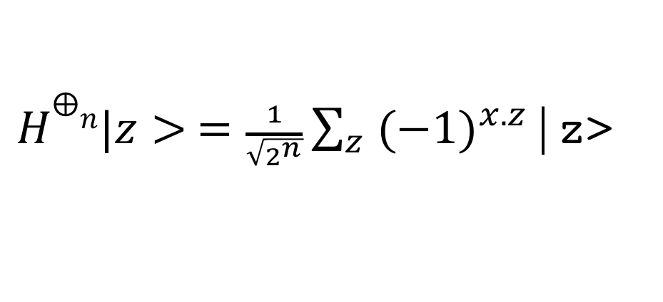
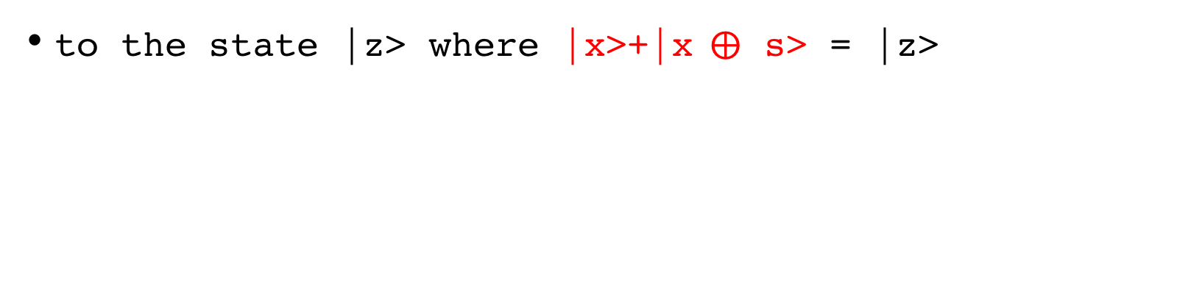
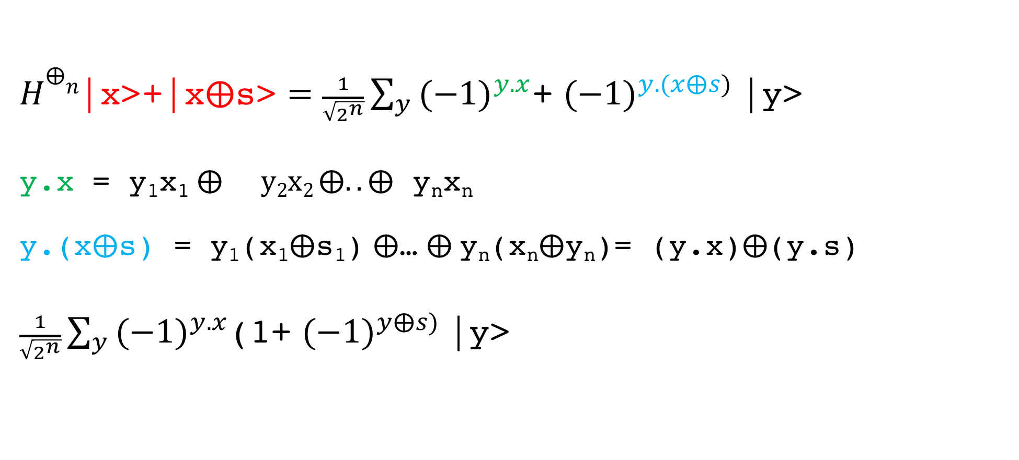
Applying the second hadamard
$H⨁n|z> =\frac{1}{\sqrt{2^{n}}}\sum_{z}{{(−1)}^{x.z}}$|z>
to the state |z> where |x>+|x$⨁$ s> = |z>
$H⨁n\text{|}\text{x}\text{>+|}\text{x}⨁\text{s}\text{>}=\frac{1}{\sqrt{2^{n}}}\sum_{y}{{(−1)}^{y.x}}$+ ${(−1)}^{y.(x⨁s)}$|y>
y.x = y₁x₁$⨁{}y2x2 ⨁..⨁$ y_{n}x_{n}
y.(x$⨁$s) = y₁(x₁$⨁$s₁) $⨁$… $⨁$y_{n}(x_{n}$⨁$y_{n})= (y.x)$⨁$(y.s)
$\frac{1}{\sqrt{2^{n}}}\sum_{y}{{(−1)}^{y.x}}$(1+ ${(−1)}^{y⨁s)}$|y>

Slide 26
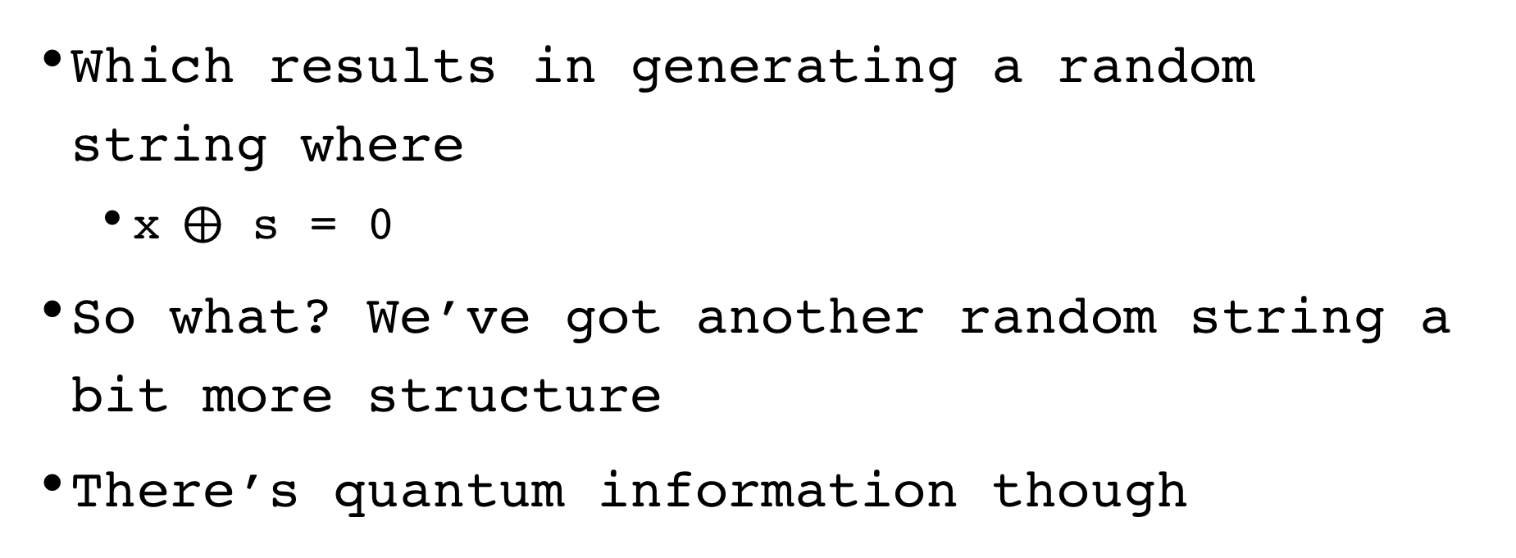
Which reduces to
Which results in generating a random string where
x$⨁$ s = 0
So what? We’ve got another random string a bit more structure
There’s quantum information though

Slide 27
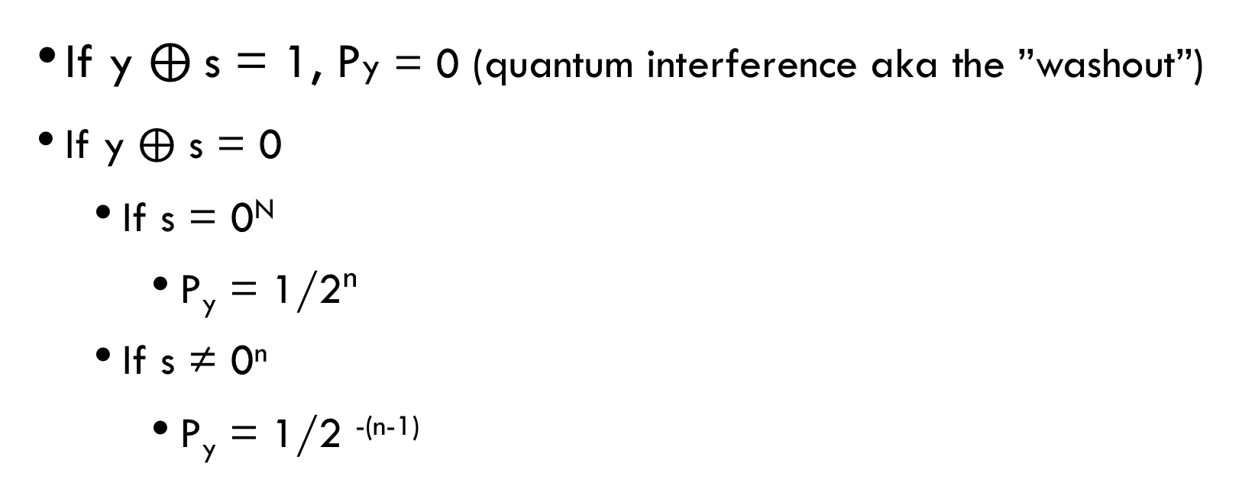

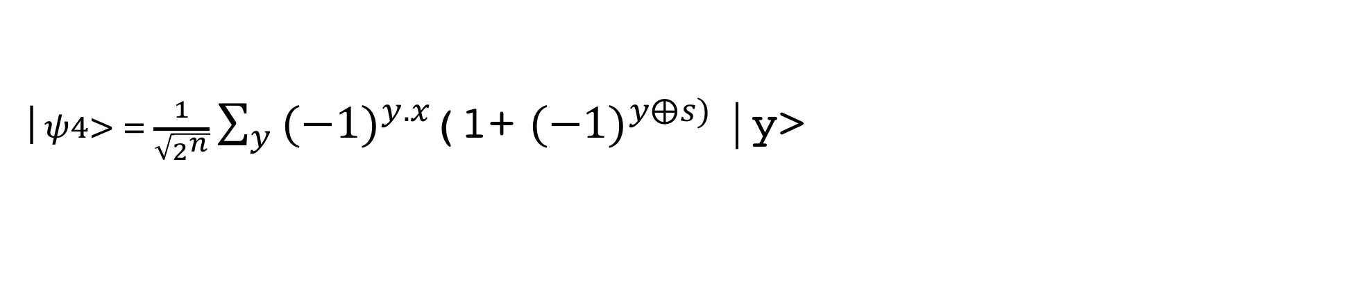
QUANTUM INTERFERence on y $⨁$ s
$\text{|}ψ4> = \frac{1}{\sqrt{2^{n}}}\sum_{y}{{(−1)}^{y.x}}$(1+ ${(−1)}^{y⨁s)}$|y>
If y $⨁$s = 1, Py = 0 (quantum interference aka the ”washout”)
If y $⨁$ s = 0
If s = 0^{N}
P_{y} = 1/2^{n}
If s ≠ 0^{n}
P_{y} = 1/2 ^{-(n-1)}

Slide 28
quantum interference
The key to quantum supremacy
Quantum Mechanics allows for negative amplitudes (aka classic probabilities)
Amplitudes can be transformed by quantum operations to be additive or subtractive

Slide 29
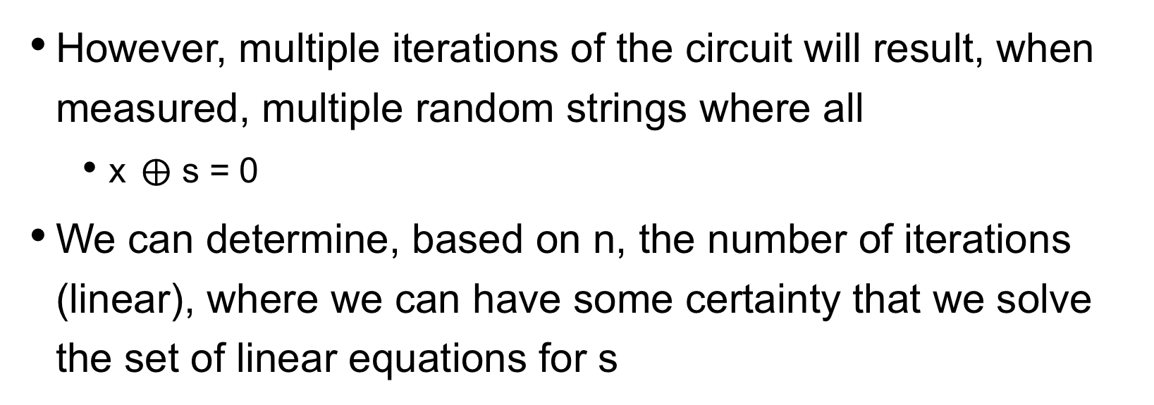
Gaussian elimination
However, multiple iterations of the circuit will result, when measured, multiple random strings where all
x$⨁$ s = 0
We can determine, based on n, the number of iterations (linear), where we can have some certainty that we solve the set of linear equations for s

Slide 30
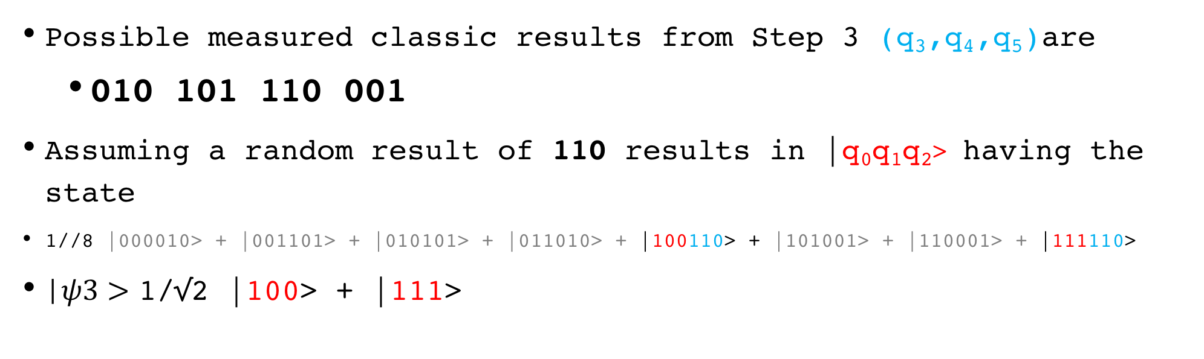
WHERE WE ARE
x | F(x)
000 | 010
001 | 101
010 | 101
011 | 010
100 | 110
101 | 001
110 | 001
111 | 110
Possible measured classic results from Step 3 (q₃,q₄,q₅)are
010 101 110 001
Assuming a random result of 110 results in |q₀q₁q₂> having the state
1//8 |000010> + |001101> + |010101> + |011010> + |100110> + |101001> + |110001> + |111110>
|$ψ3>$ 1/√2 |100> + |111>

Slide 31
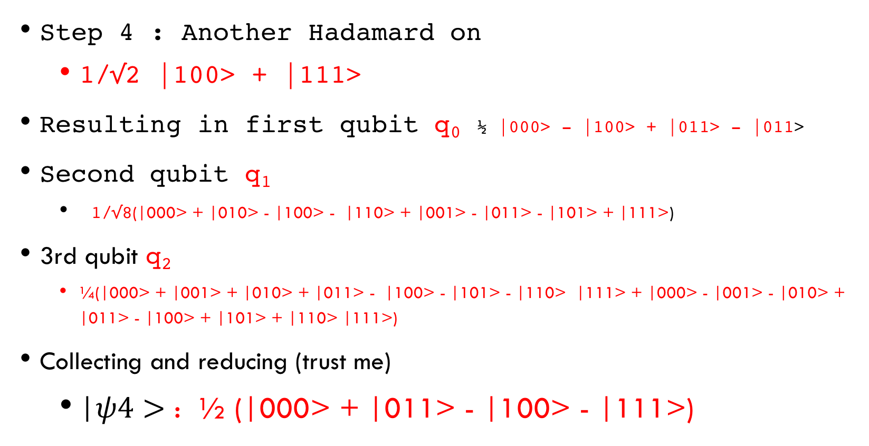
RUNNING Example (4)
Step 4 : Another Hadamard on
1/√2 |100> + |111>
Resulting in first qubit q₀ ½ |000> - |100> + |011> - |011>
Second qubit q₁
1/√8(|000> + |010> - |100> - |110> + |001> - |011> - |101> + |111>)
3rd qubit q₂
¼(|000> + |001> + |010> + |011> - |100> - |101> - |110> |111> + |000> - |001> - |010> + |011> - |100> + |101> + |110> |111>)
Collecting and reducing (trust me)
|$ψ4>$ : ½ (|000> + |011> - |100> - |111>)

Slide 32
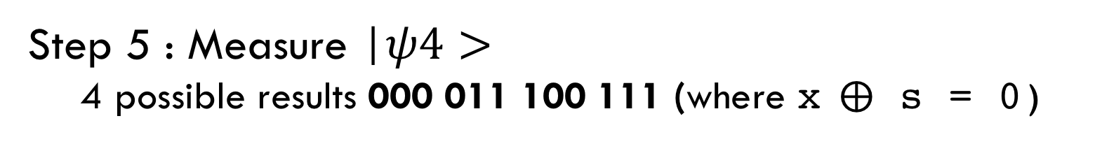
|$ψ4>$ : ½ (|000> + |011> - |100> - |111>)
Step 5 : Measure |$ψ4>$
4 possible results 000 011 100 111 (where x$⨁$ s = 0)

Slide 33
Overall execution
Quantum processing for Simon’s
Classic Processing of linear equations
011
0 + s₂ + s₃ = 0 mod 2
Run 1
100
s₁ + 0 + 0 = 0 mod 2
Run 2
111
s₁ + s₂ + s₃ = 0 mod 2
Run 3

Slide 34
RUNNING Example (5)
Measure results 000 011 100 111
Step 6 Repeated iterations -> linear equations
(s₁x₁ + s₂x₂ + s₃x₃ = 0 mod 2)
000 => 0 + 0 + 0 = 0 mod 2
011 => 0 + s₂ + s₃ = 0 mod 2
100 => s₁ + 0 + 0 = 0 mod 2
111 => s₁ + s₂ + s₃ = 0 mod 2
Classic Gaussian elimination => s = 011
x | F(x)
000 | 010
001 | 101
010 | 101
011 | 010
100 | 110
101 | 001
110 | 001
111 | 110

Slide 35
The recipe
Set up a superposition
Apply the function x + (x $⨁$ s) to the superposition using an oracle
Fourier sample the superposition to get a random x : x . s = 0 (mod 2)
Repeat steps 1 & 2 n-1 times to generate n-1 linear equations in s
Solve for s

Slide 36
How many iterations?
To solve a set of linearly independent equations with n parameters, we need at least n - 1 equations
However, the quantum algorithm may generate multiple random (yet accurate) equations of the form s₁x₁ + s₂x₂ + s₃x₃ = 0 mod 2
Bonus : any results can just be checked

Slide 37
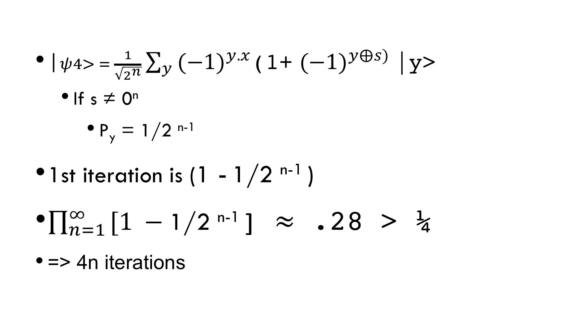
How many iterations?
$\text{|}ψ4> = \frac{1}{\sqrt{2^{n}}}\sum_{y}{{(−1)}^{y.x}}$(1+ ${(−1)}^{y⨁s)}$|y>
If s ≠ 0^{n}
P_{y} = 1/2 ^{n-1}
1st iteration is (1 - 1/2 ^{n-1} )
$\prod_{n=1 }^{∞}{[1 −\text{1/2 }\text{n}\text{−1}}$] $≈$ .28 > ¼
=> 4n iterations

Slide 38
It’s all about complexity reduction
The classical version has a 2~^{n} use of memory and time (e.g. running through the table twice)
The quantum version doesn’t. It uses superposition and quantum fourier transforms to reduce to a linear problem relating to N
It’s a probabilistic answer with a probabilistic number of steps

Slide 39
END of presentation

